Slide 1
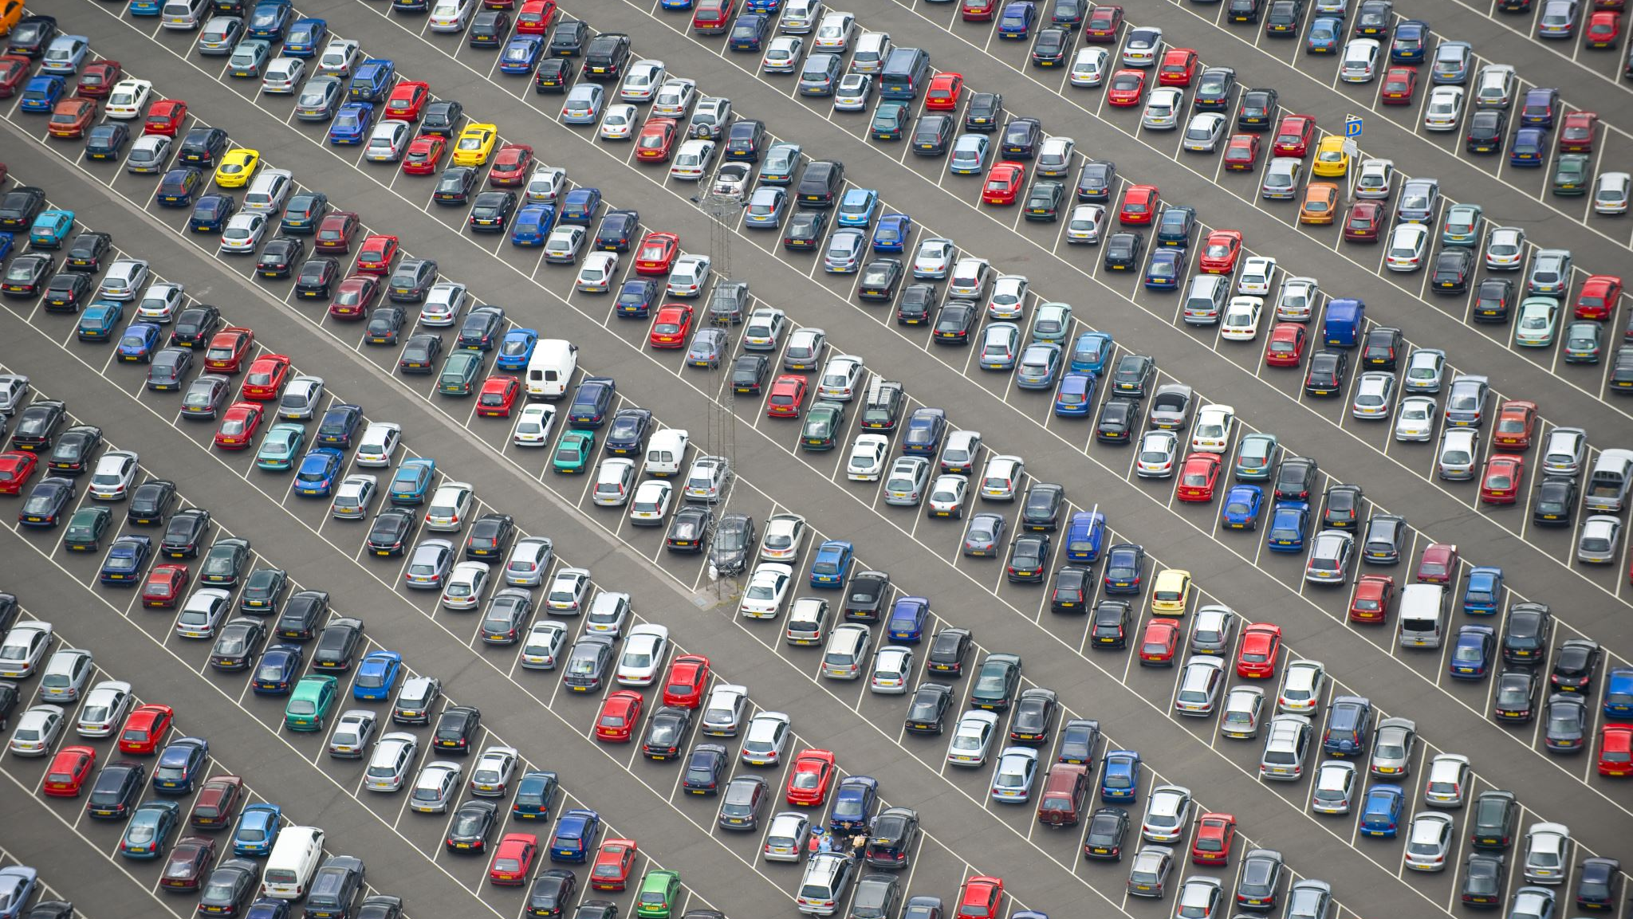
Crash Dummies Project name: Car Crash
Members: Shreya Udeshi, Ra Ish Andrews, Ellis Purwanto

Slide 2
Table of contents
Introduction
Data Elements
Location Data Frame
Analysis
Visualization
Person Data Frame

Slide 3
Introduction

Slide 4
Data Elements

Slide 5
Location Data frame

Slide 6
Visualization

Slide 7
Analysis

Slide 8
Persons Data frame

Slide 9
Visualization

Slide 10
Analysis

Slide 11
Time data frame

Slide 12
Visualization

Slide 13
Analysis

Slide 14
Combined Data frames

Slide 15
Visualization

Slide 16
Analysis

Slide 17
Results

Slide 18
Conclusion

